Slide 1
HireAC
YOUR HOW TO GUIDE

Slide 2
HireAC Guide Sections
Getting Started with HireAC
Cooperative Education Module in HireAC
Changing Preferred Name in HireAC
Downloading the Co-op Work Permit Confirmation Letter
Co-op Documents Page in HireAC
Co-op Job Postings Page in HireAC
Setting up Job Alerts in HireAC
Co-op Interviews Page in HireAC
Co-op Job Offers in HireAC
Co-op Work-term record in HireAC
Booking a Peer Review meeting in HireAC
Events And Workshops Module in HireAC
Career & Employment Module in HireAC

Slide 3
10. Co-op Work Term Record in HireAC
Work Term details page and Co-op Work Term assignments in HireAC

Slide 4
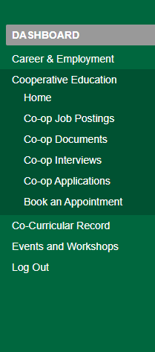
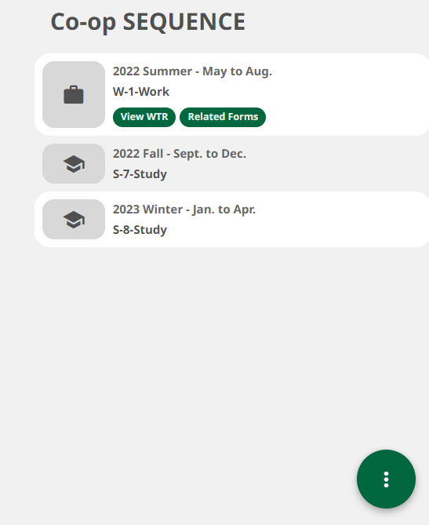
Your Co-op Work Term Record in HireAC
Go to Co-op module, Home
Click on View WTR button in your Co-op Sequence information on the right-hand side. WTR stands for Work Term Record details.
Once you click on WTR, you will be redirected to a new page where you will find your detailed Work Term Record and your Co-op work term assignments in HireAC.
1
1
2
4

Slide 5
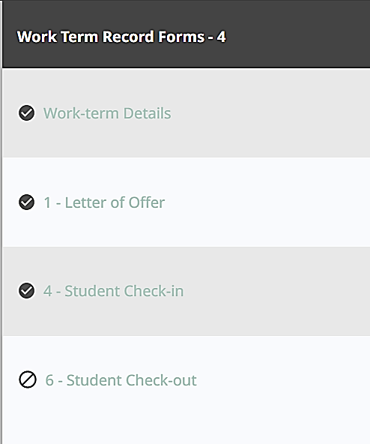
Co-op Work Term Assignments in HireAC
Co-op work term assignments (Work Term Record Forms) and their status will be available to you in your Co-op Work Term Record
Click on each one to open and complete the respective assignment.
Work-term Details includes information about your current work term such as the job description and your supervisor contact.
Supervisor information can be updated by clicking on the Edit option.
Letter of Offer - the Co-op and Career Centre needs this letter to ensure that your conditions of employment meet Co-op requirements.
Student Check-in is a brief survey that lets Co-op Student Advisor know how your work terms are progressing
Student Check-out is a brief survey that helps the Co-op and Career Centre gain insight into your Co-op experience and gives you a chance to provide feedback and suggestions to our team.
5

